Slide 1
REQUIRED DOCUMENTATION Student Mess System MAJOR PROJECT – MC214

Slide 2

STUDENT MESS SYSTEM

Slide 3
STUDENT MESS SYSTEM
REQUIREMENTS MODEL
DESIGN MODEL
CLASS DOMAIN DIAGRAM
USE CASE DIAGRAM
USE CASE FULLY DIAGRAM
ACTIVITY DIAGRAM
SYSTEM SEQUENCE DIAGRAM
DESIGN CLASS DIAGRAM
INTERACTION DIAGRAM
COMPONENT DIAGRAM
PACKAGE DIAGRAM
ERD DIAGRAM

Slide 4
REQUIREMENT MODEL
1.CLASS DOMAIN
2.USE CASE DIAGRAM
3.USE CASE FULLYDESCRIPTION
4.ACTIVITY DIAGRAM
5.SYSTEM SEQUENCE

Slide 5
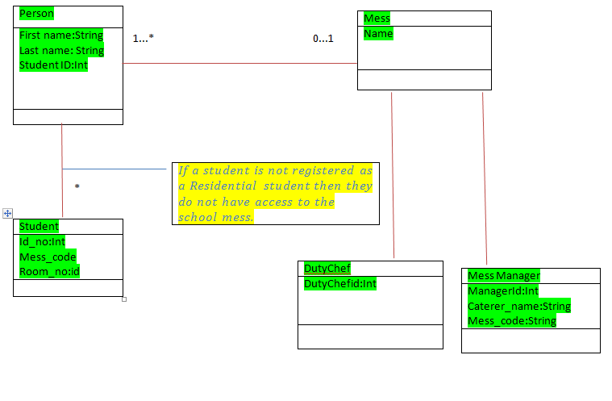
CLASS DOMAIN DIAGRAM

Slide 6
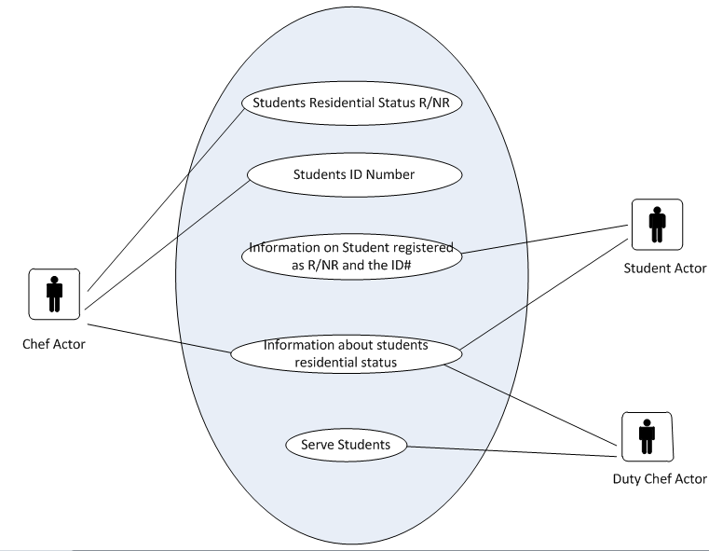
USE CASE DIAGRAM

Slide 7
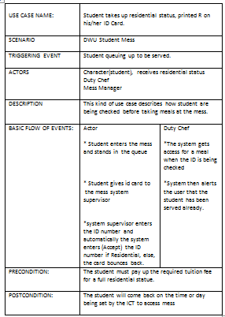
USE CASE FULLY DESCRIPTION

Slide 8
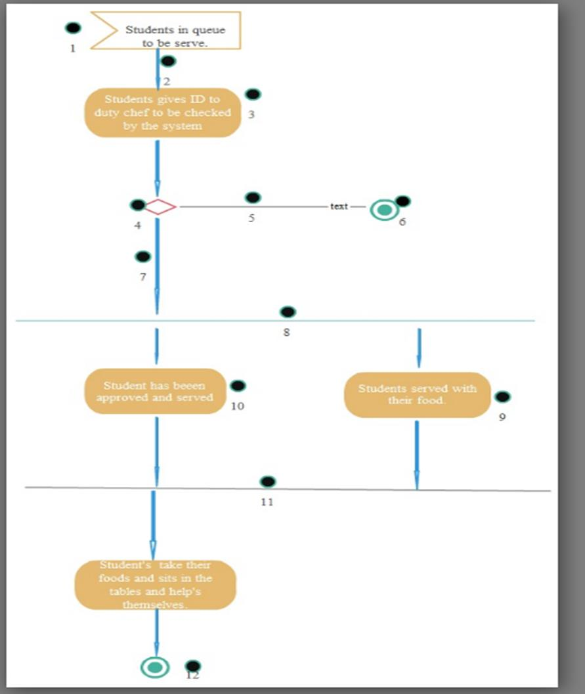
ACTIVITY DIAGRAM

Slide 9
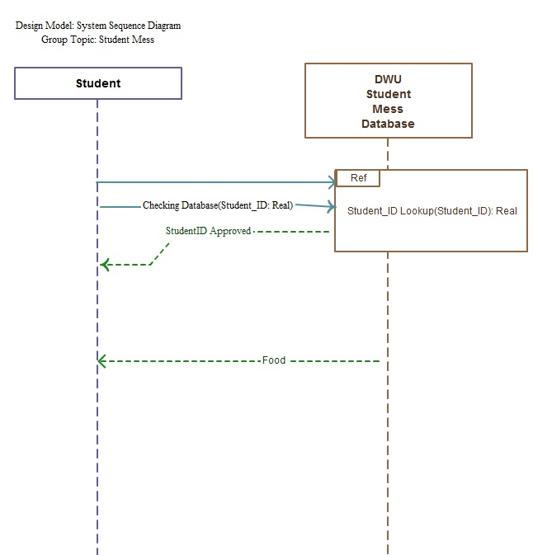
SYSTEM SEQUENCE DIAGRAM

Slide 10
DESIGN MODEL
1.DESIGN CLASS DIAGRAM *CRC cards
2.INTERACTION DIAGRAM *sequence diagram
3.COMPONENT DIAGRAM
4.PACKAGE DIAGRAM
5.ENTITY RELATION DIAGRAM

Slide 11
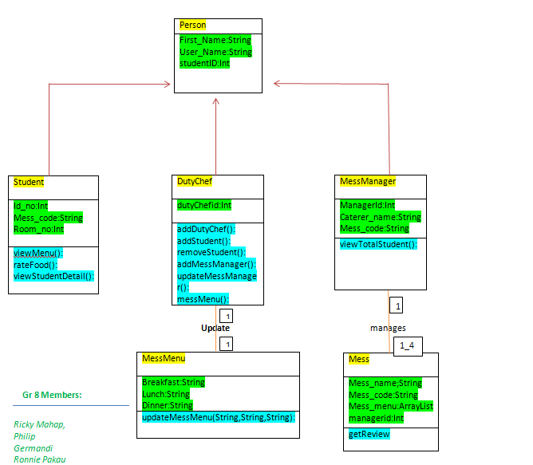
DESIGN CLASS DIAGRAM

Slide 12
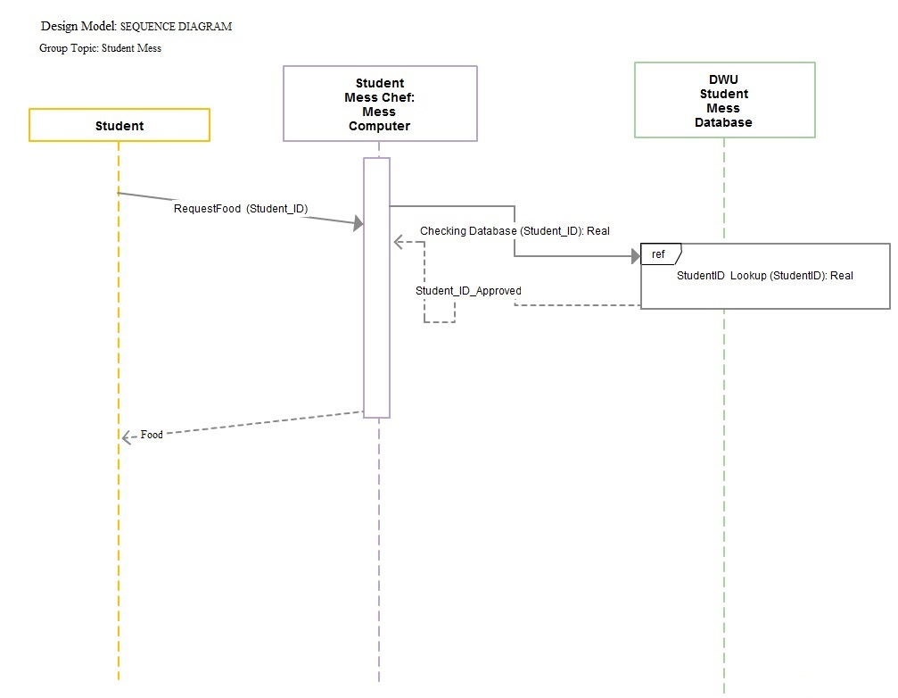
INTERACTION DIAGRAM *SEQUENCE DIAGRAM

Slide 13
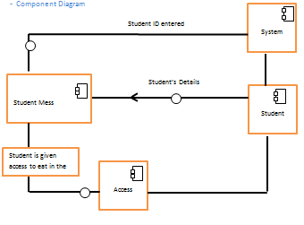
COMPONENT DIAGRAM

Slide 14
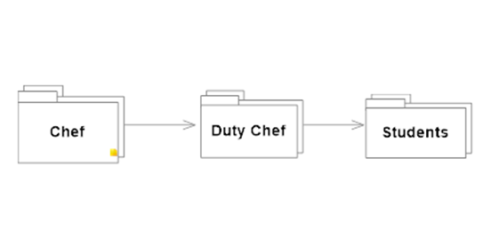
PACKAGE DIAGRAM

Slide 15
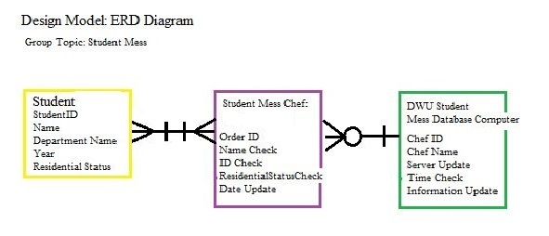
ENTITY RELATION DIAGRAM.

Slide 16

Tools: - Microsoft Visual Studio 2010 - MySQL

Slide 17

Any Questions

